Slide 1
Model Result Of Predictive
Customer Buying Behavior
By: Ayman Mohamed

Slide 2
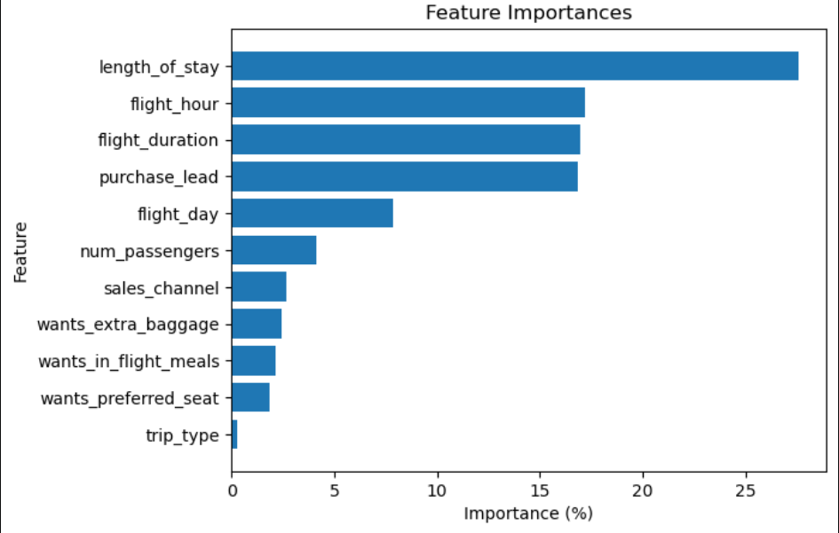
Results Of Model
From our feature importance of our model, we know that
The influencing factors of customers to complete their booking
length_of_stay:number of days spent at destination,
Filght Hours and Duration
and purchase_lead : number of days between travel date and booking date

